Slide 1




PROJECT TITLE
1
Into the Pokéverse

Slide 2
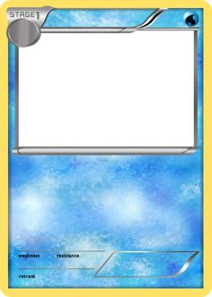
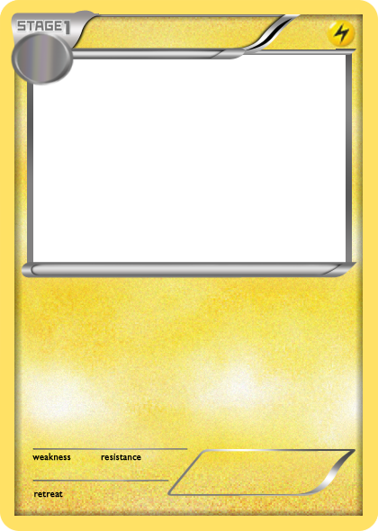
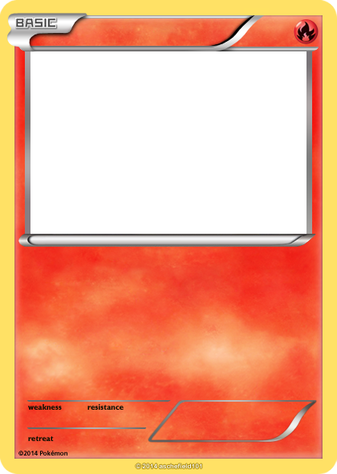


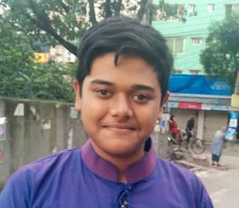
SUBMITTED BY:
2
Ridwan
Sartaj
Rifat
Ridwan Mahbub ID- 180041230
Syed MD. Sartaj Ekram ID- 180041204
Syed Rifat Raiyan ID- 180041205

Slide 3
PROJECT MOTIVATION
3
This is a passion-project for us, as the cartoon Pokémon was a core part of our childhood.
Collecting and trading Pokémon cards was a popular hobby back in our childhood.
Playing Pokémon games in Nintendo Gameboy was our favorite pastime.
Nostalgia for the franchise is the main driving force behind this project.

Slide 4
OBJECTIVES
Developing a game using C programming language taking inspiration from the Pokémon games of Nintendo console .
Creating a map for the game where the player can move around the explore different locations.
Implementing a strategic 3 versus 3 battle where the players can use Pokémon's of different type and battle items to their advantage.

Slide 5
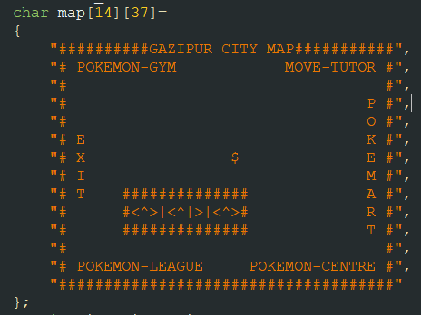
PROJECT FUNCTIONALITIES
5
Maps: The player has the liberty to move around the map of a city and visit different locations. The map is implemented using character array in C language.

Slide 6
PROJECT FUNCTIONALITIES
1)Difficulty level:
The game has 3 preset difficulty level that are implemented by 3 different functions. The player can choose a difficulty to his liking which changes the actions of the opponent.

Slide 7



PROJECT FUNCTIONALITIES
6
1) Choosing the Pokémons: After starting the game, the player will form a roster by choosing 3 Pokémons from a pool of multiple ones and the CPU will then proceed to choose 3 Pokémons.
CPU
Player

Slide 8
PROJECT FUNCTIONALITIES
7
3) Combat: The combat will be a turn-based system where each player will perform their move in subsequent turns. Every Pokémon has a set of specific skills which deal damage to the opponent Pokémon and thus decrease their Health Points (HP) by a specified number. Every Pokémon and move has got a specific type making it weak or strong against others types.

Slide 9
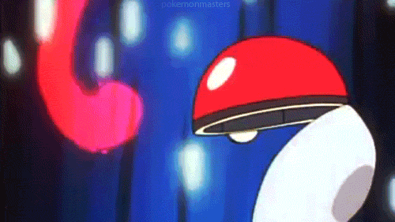
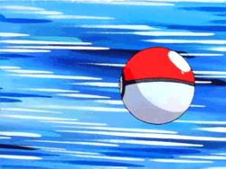
PROJECT FUNCTIONALITIES
8
3) Switching between Pokémons: The player has the option to switch between Pokémons if they feel it’s necessary in the middle of the fight. This has been implemented using linked list.
If HP low
Switch Pokémon
Resume Fight

Slide 10

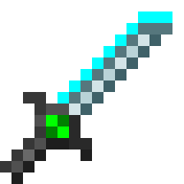

PROJECT FUNCTIONALITIES
9
4) Using utility items: The player may choose to use healing potions which regenerate the Pokémon's HP. There are items which will increase the offense or defense.
Super Potion HP+=70
Potion HP+=30
Healing Potions
Dire Hit Critical Hit++
X Attack Damage++
Damage Items
Defensive Items
X Defense Damage Received--
Tough Candy XL Damage Received--

Slide 11
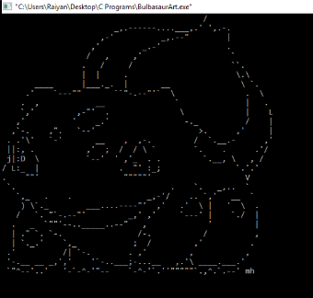

PROJECT FUNCTIONALITIES
10
5) Image Display: Images of the Pokémons are depicted with ASCII character art and implemented in the program by using FILE pointers.

Slide 12
PROJECT TIMELINE:
12
15.08.2019 - A simple version of the game.
30.08.2019 - Integration of features like map, healing items and more playable Pokémons. 15.09.2019 - Adding a suitable plot for the game.
31.09.2019 - A beta version of the game which will be subjected to further testing and improvement. 05.10.2019 - Debugging the game and adjusting and tweaking minor details.
15.10.2019- Final version of the game.

Slide 13
FUTURE ENDEAVOURS
13
Using graphics in place of ASCII art.
Expanding the map to include more cities and places.
Implementing a system of catching wild Pokémon.
Introducing more Pokémon's and different and different mechanics like evolution.

Slide 14
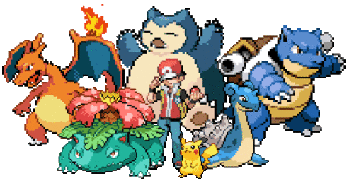
14
The End Thank You for Listening

